Slide 1
AAQC - Autonomous air quality control
Group 16 - Tobias Haller, Jonas Hofer, and Christian Müller

Slide 2


Slide 3
Agenda
Sensors and Actuators
System Architecture
Demo Setup
Live Demo

Slide 4
Sensors and Actuators
Humidity (outside)
Temperature (inside and outside)
CO₂ (inside)
Particulate matter (inside and outside)
Air-conditioning
Heater
Ventilation
Air-purifier
Notes:
Inside / outside

Slide 5
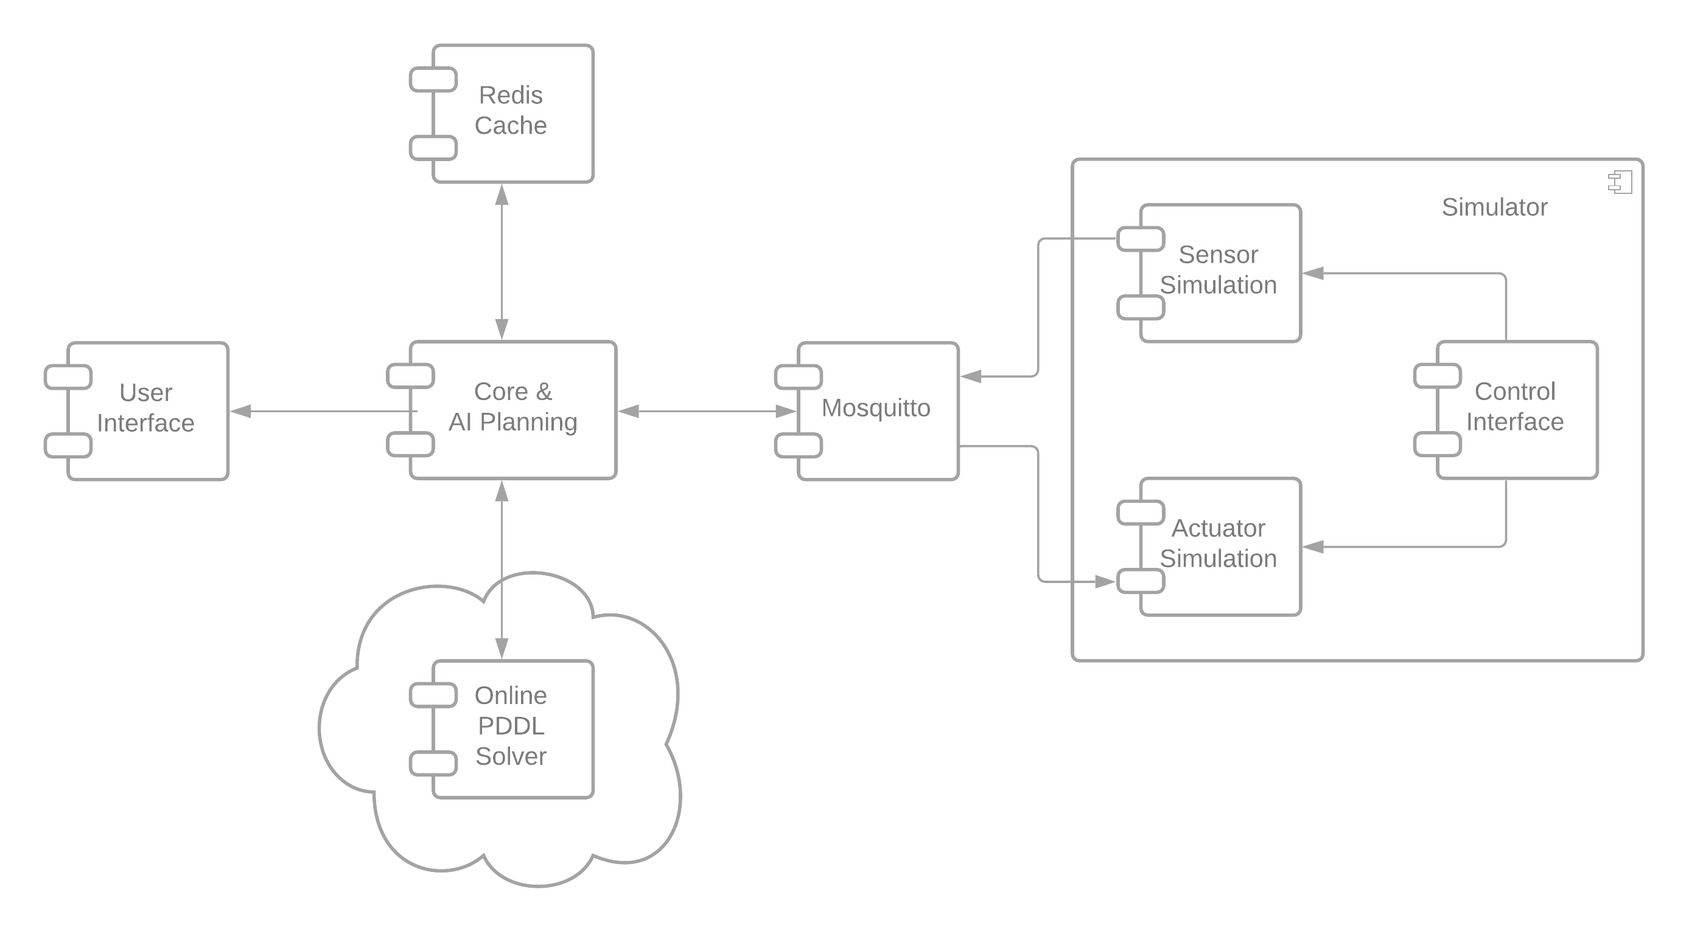
Architecture

Slide 6
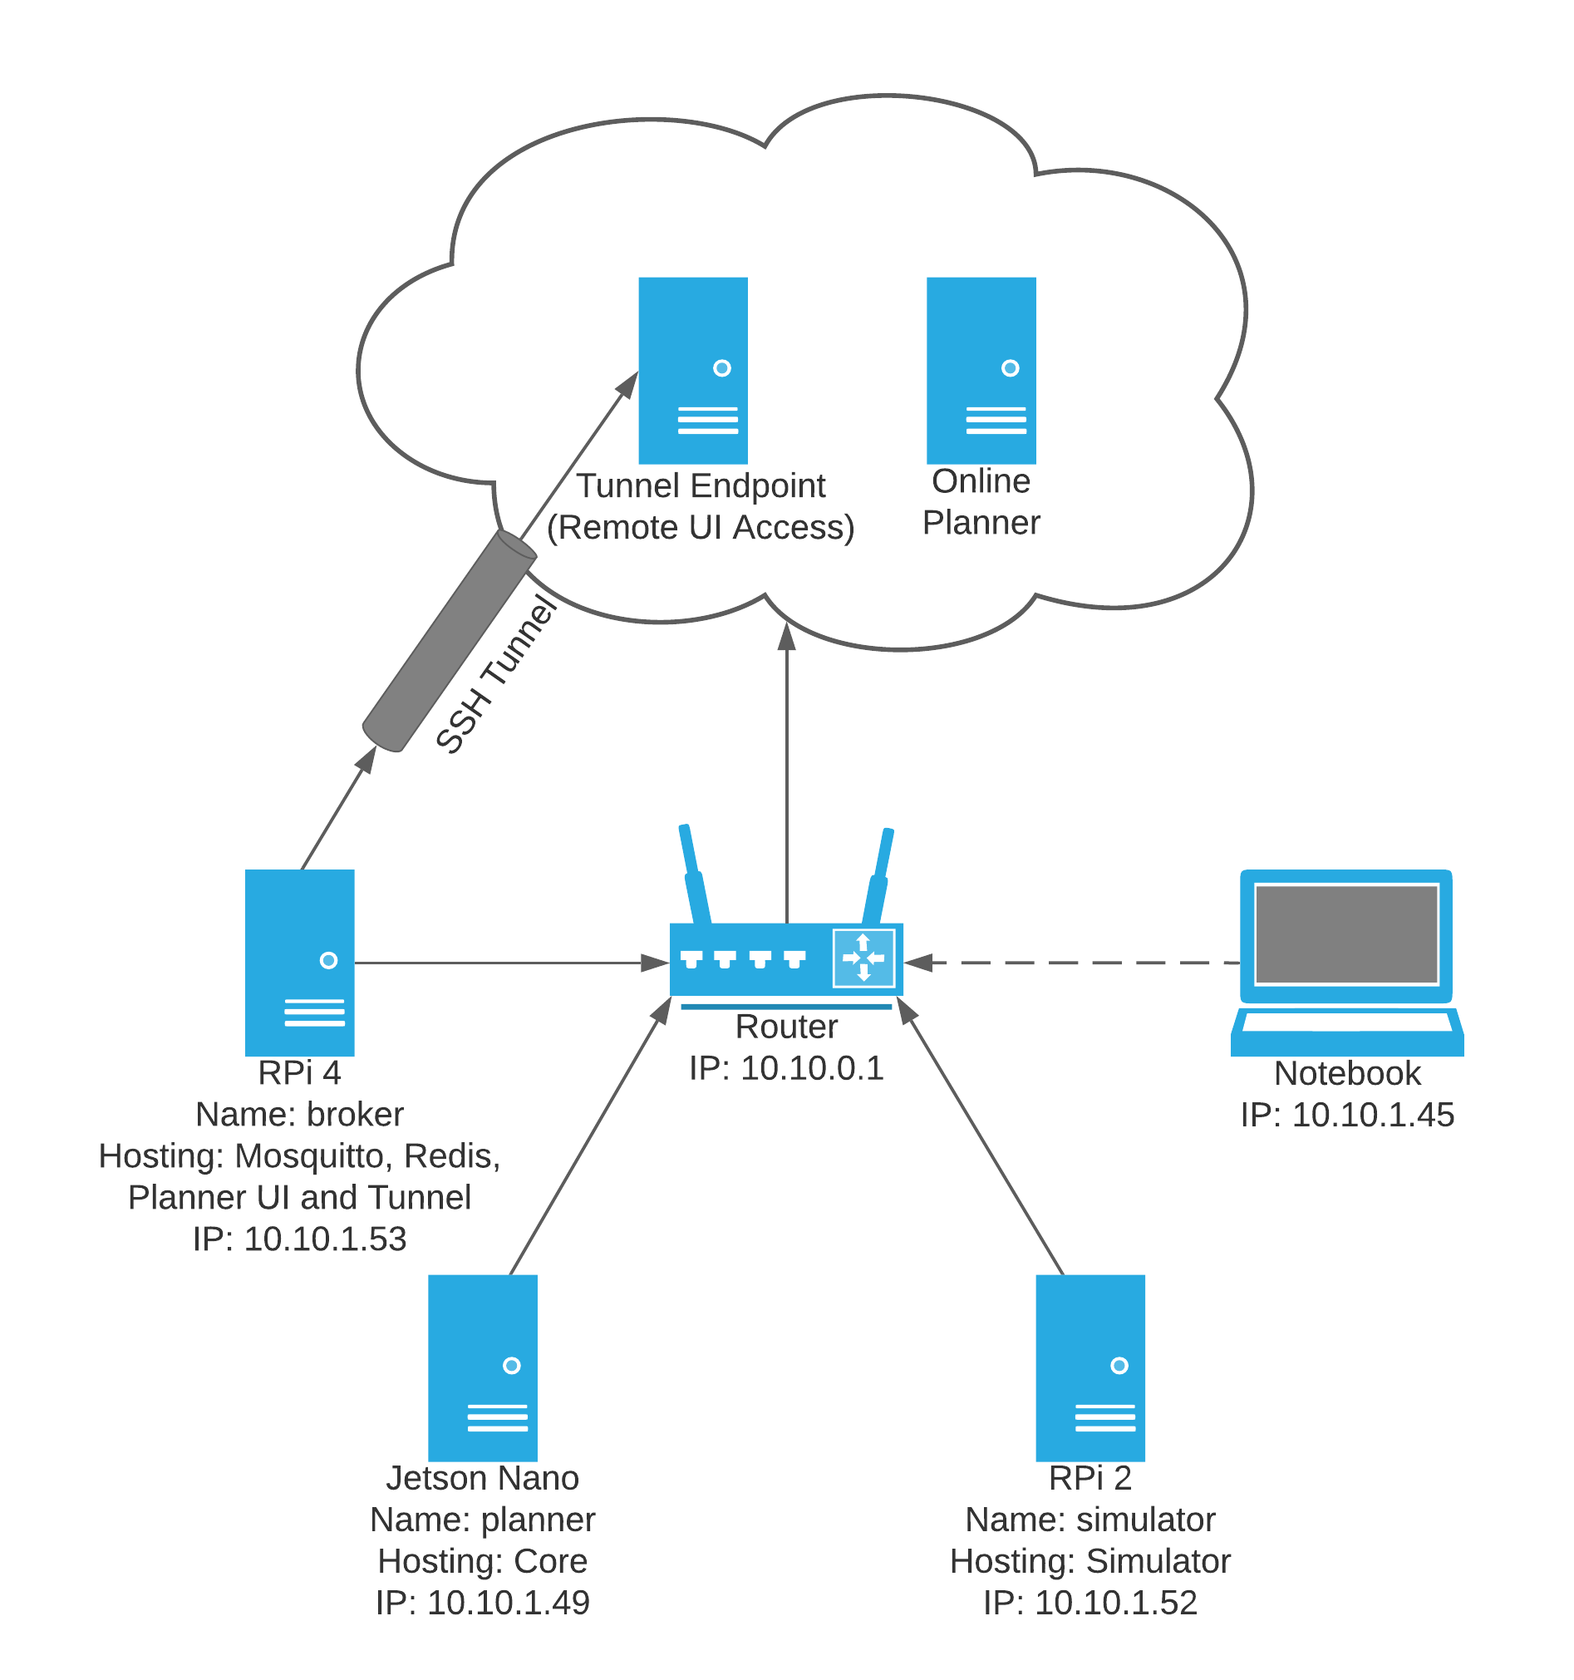
Demo setup

Slide 7
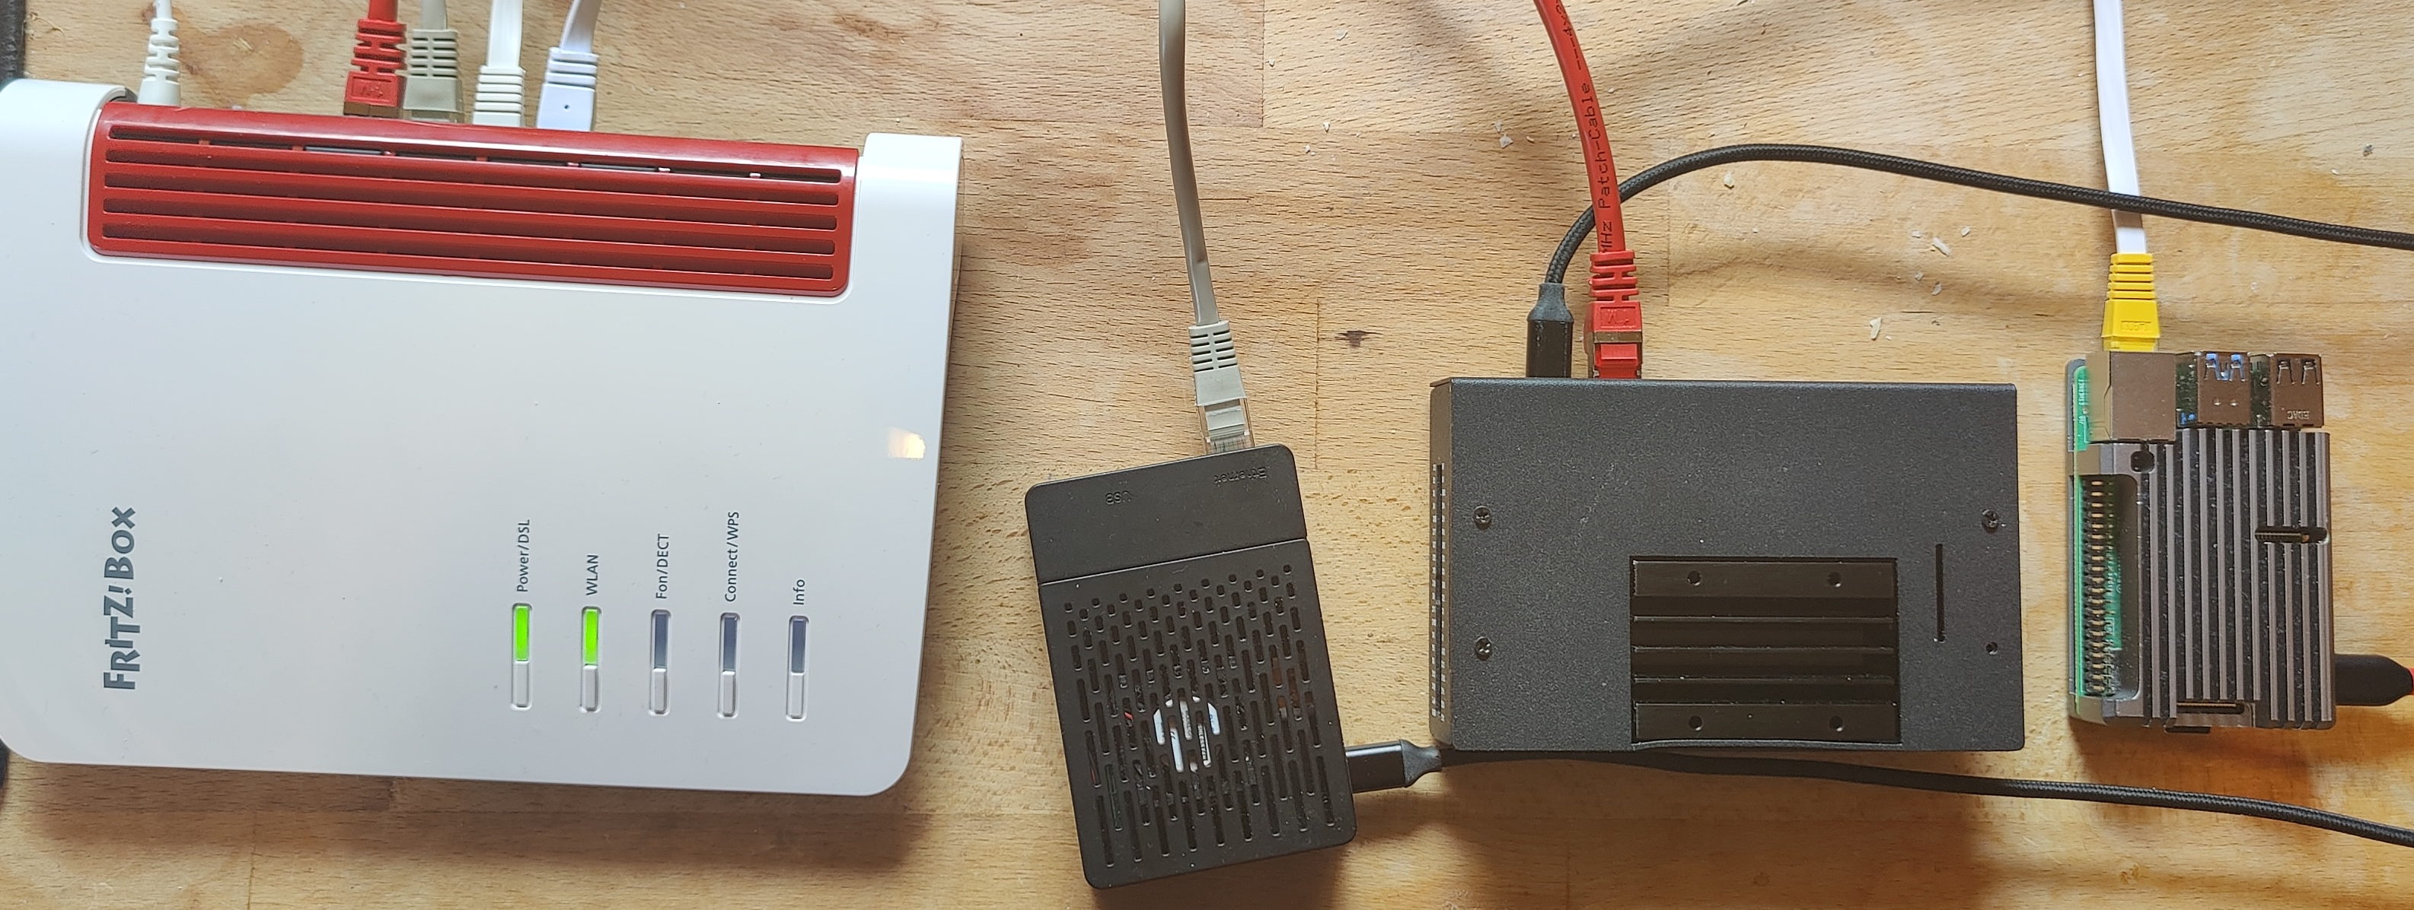

Slide 8
AAQC - Live Demo

Slide 9
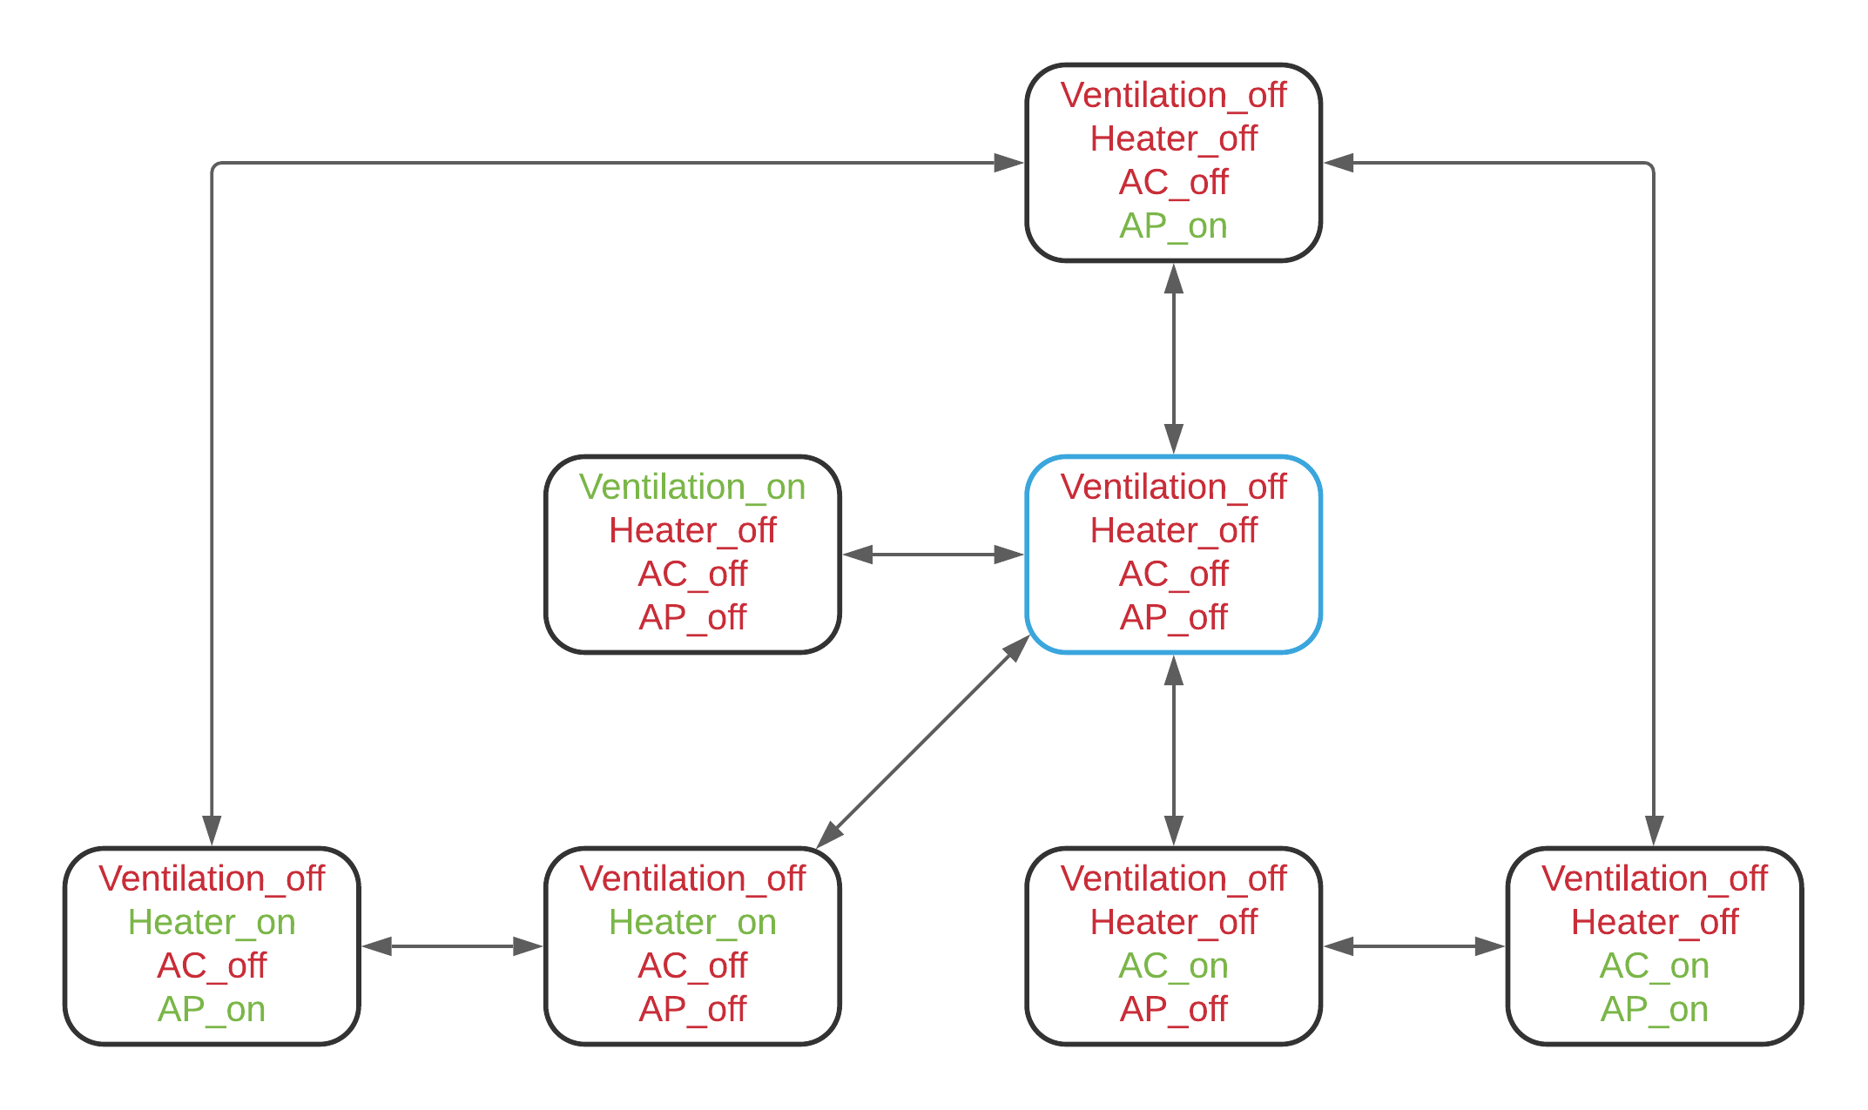
IoT AI Planning Model

Slide 10
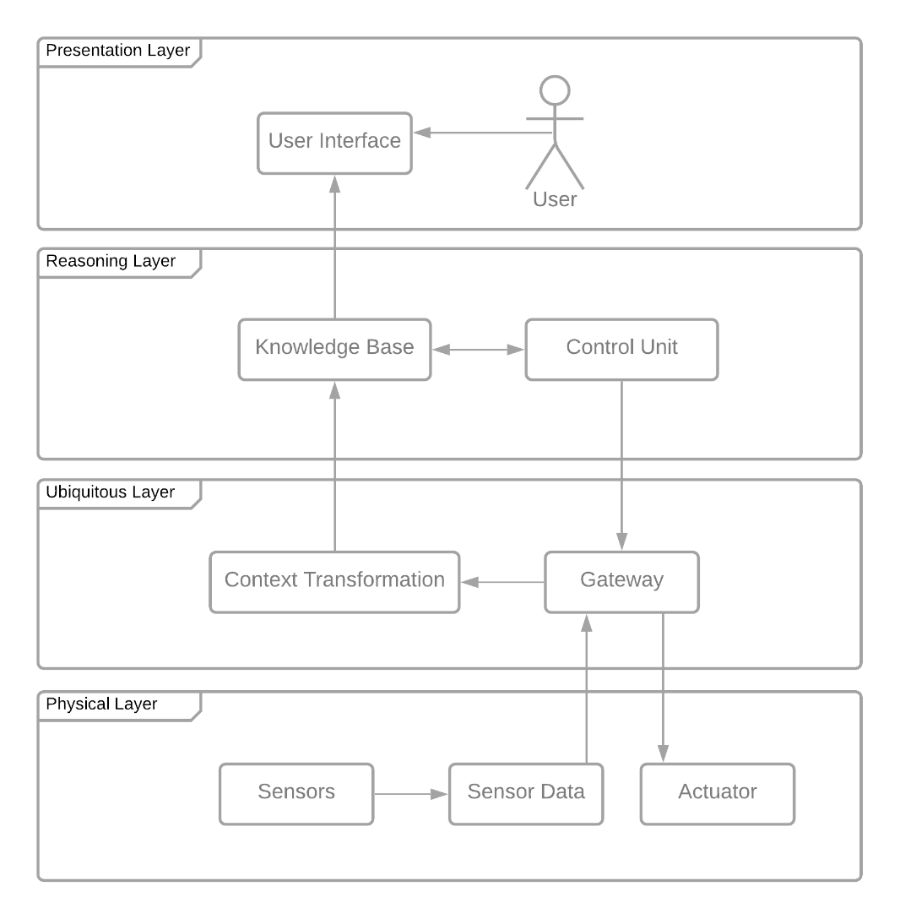
System design

